Slide 1


Bài giảng điện tử
Unit 1: Towns and Cities
Lesson 7: Writing

Slide 2


Slide 3

UNIT 1: TOWNS and CITIES
LESSON 7: WRITING

Slide 4
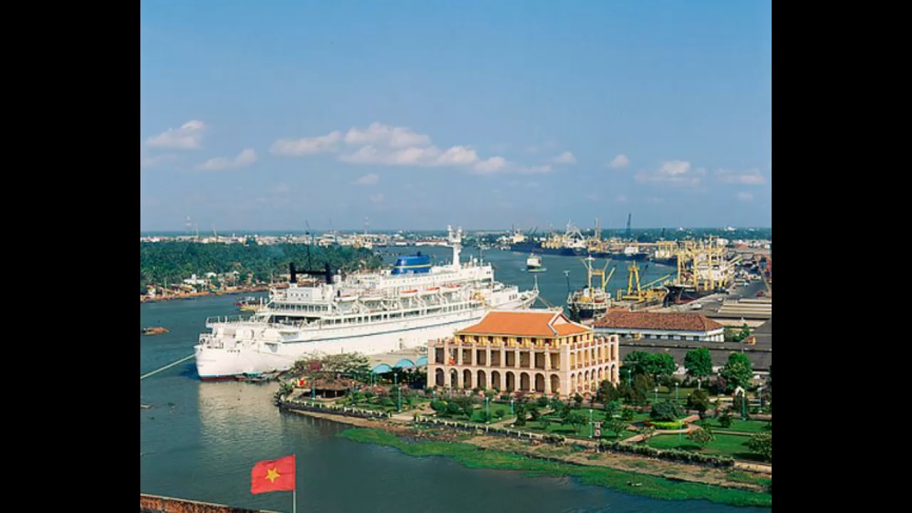

Slide 5

What is your favorite places?
Which part you never visit? Why?

Slide 6
THINK! Check the meanings of the words in the box. Which has your town or city got?
Buildings
Factories
Amusement parks
A zoo
Shopping malls

Slide 7
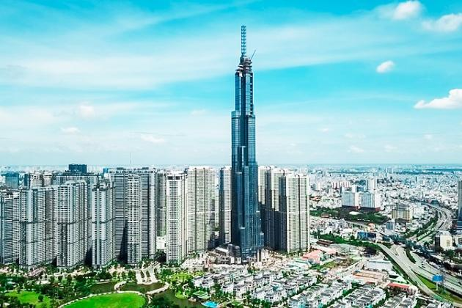
THINK! Check the meanings of the words in the box. Which has your town or city got?
buildings

Slide 8
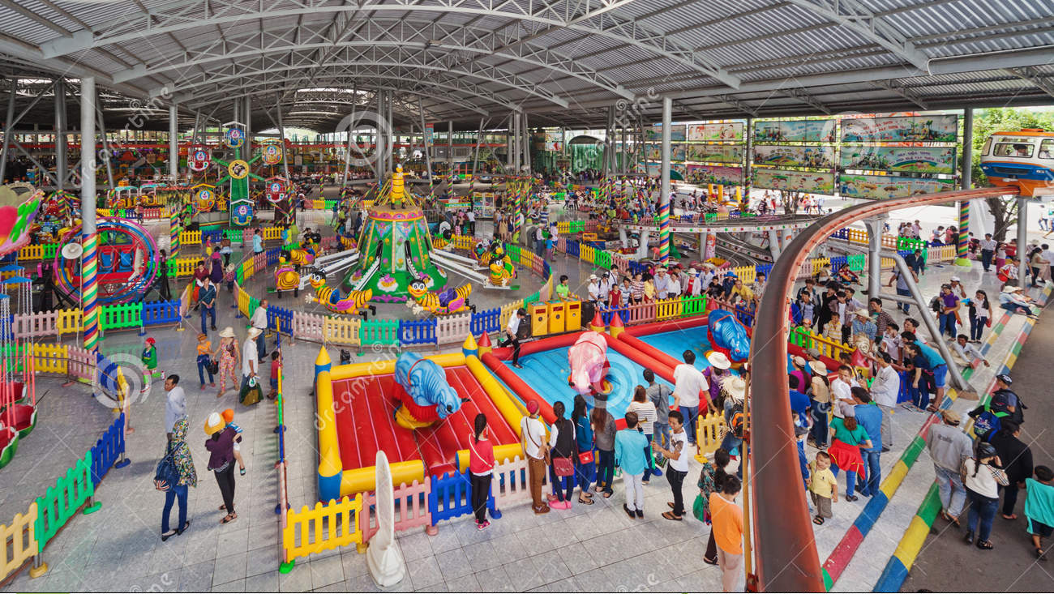
THINK! Check the meanings of the words in the box. Which has your town or city got?
amusement parks

Slide 9
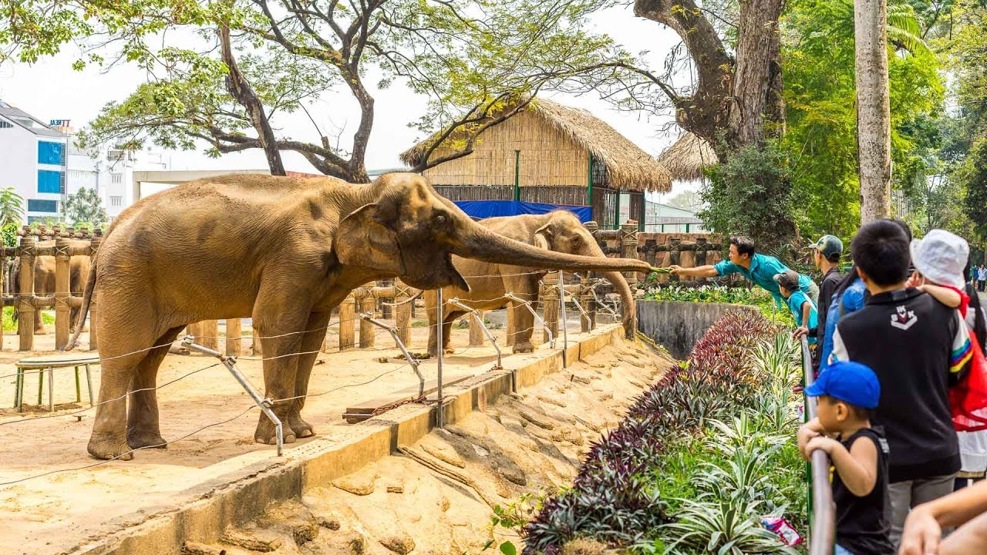
THINK! Check the meanings of the words in the box. Which has your town or city got?
zoo

Slide 10

THINK! Check the meanings of the words in the box. Which has your town or city got?
Shopping malls

Slide 11
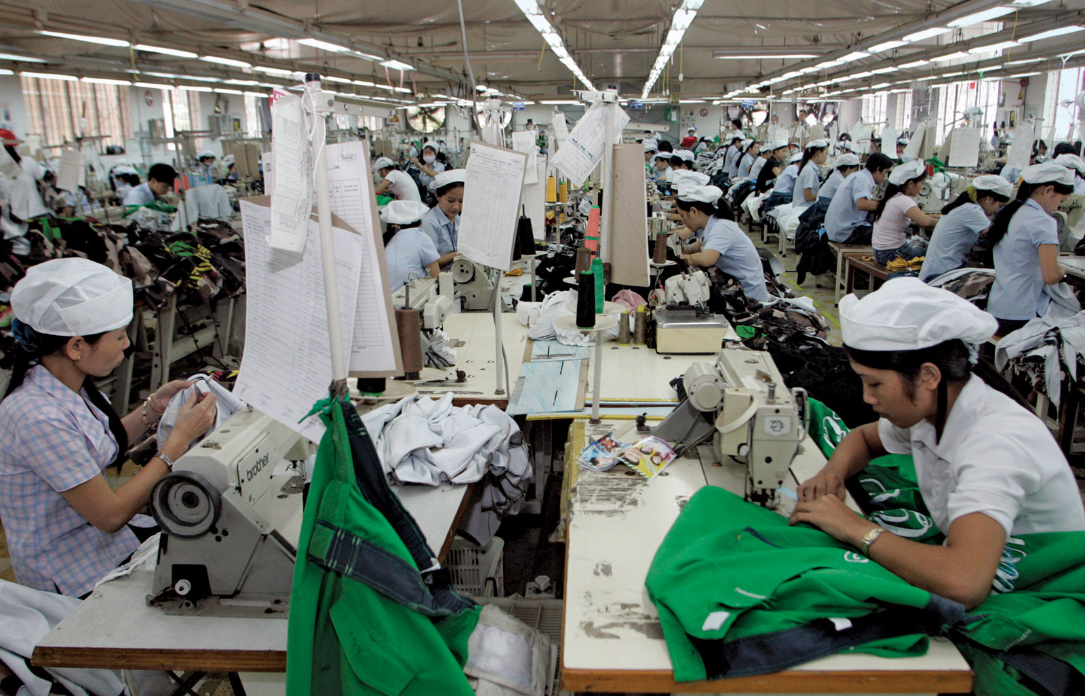
THINK! Check the meanings of the words in the box. Which has your town or city got?
factory

Slide 12
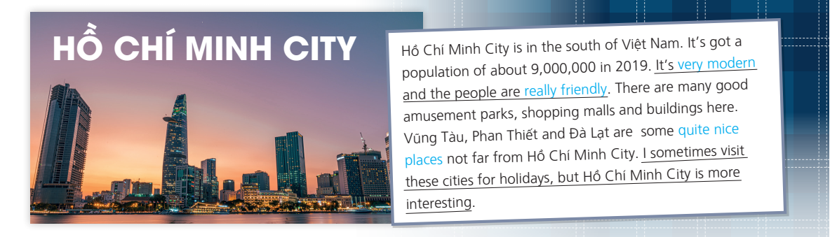
EXERCISE 1:Read the description of Ho Chi Minh city. Which words in the THINK exercise are in the text?
+ Buildings + factories + shopping malls
+ amusement parks + a zoo

Slide 13
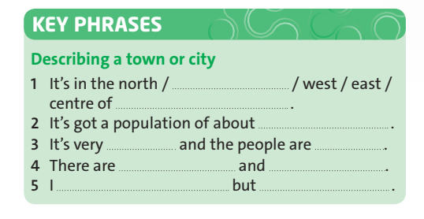
EXERCISE 2: Complete the Key Phrases with words from the text.

Slide 14
EXERCISE 2: Complete the Key Phrases with words from the text.
1. It is in the south centre of Việt Nam.
2. It’s got a population of about 9,000,000.
3. It’s very modern and the people are really friendly.
4. There are many good amusement parks, shopping malls and buildings here.
5. I sometimes visit Vũng Tàu, Phan Thiết and Đà Lạt, but Hồ Chí Minh City is more interesting.

Slide 15
Exercise 3: Look at the phrases in blue in the text. Then underline the correct words.
1. When an adjective and a noun are together, the adjective is before/after the noun.
2. We use really, very and quite before/after an adjective.

Slide 16
Exercise 4: Compound sentences. Look at the underlined sentences in the text. Then circle the correct words.
1. We use and to join similar/opposite independent clauses in a compound sentence.
2. We use but to join similar/opposite independent clauses in a compound sentence.

Slide 17
Exercise 4: Order the words to make sentences.
1. old town / 152,160 / Hội An Town / and / is / got /a population / it’s / of about / an
→ Hội An Town is an old town, and it’s got a population of about 152,160.
2. sometimes / stays in Hà Nội / Mr Nam / but /in Hồ Chí Minh City / lives / he
→ Mr Nam sometimes stays in Hà Nội, but he lives in Hồ Chí Minh City.

Slide 18
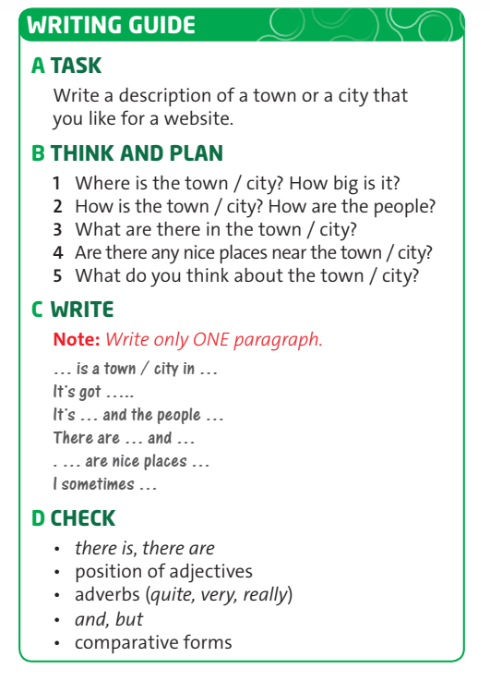
EXERCISE 3: Read the study strategy and follow the instructions.

Slide 19



- Learn by heart all the new words
- Prepare for next lesson

Slide 20



www.phuongnam.edu.vn

